Slide 1
Lewistown Junior High 7th Grade Science
Brewery Flats
Fall Trip
September 22, 2010

Slide 2
Fall and Spring Activities
Fall
Spring
Stream Cross-sections
Stream Bottom Sampling
Macro-invertebrate Studies
Water Quality Studies
Bird Identification
Macro-invertebrate Studies

Slide 3
Macro-invertebrate Collection
Part 1

Slide 4
Macro-invertebrate Collection

Slide 5
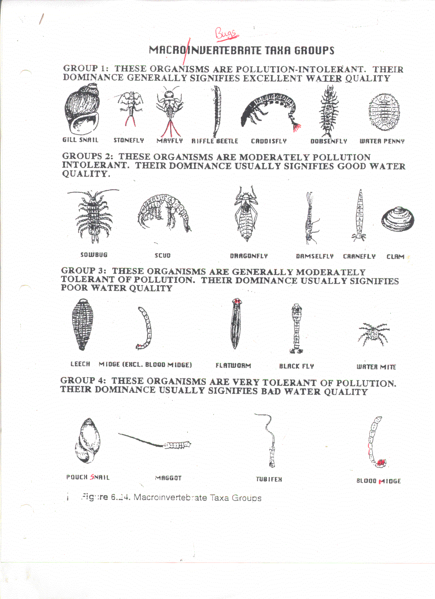
Water Quality based on “Bugs” collected

Slide 6
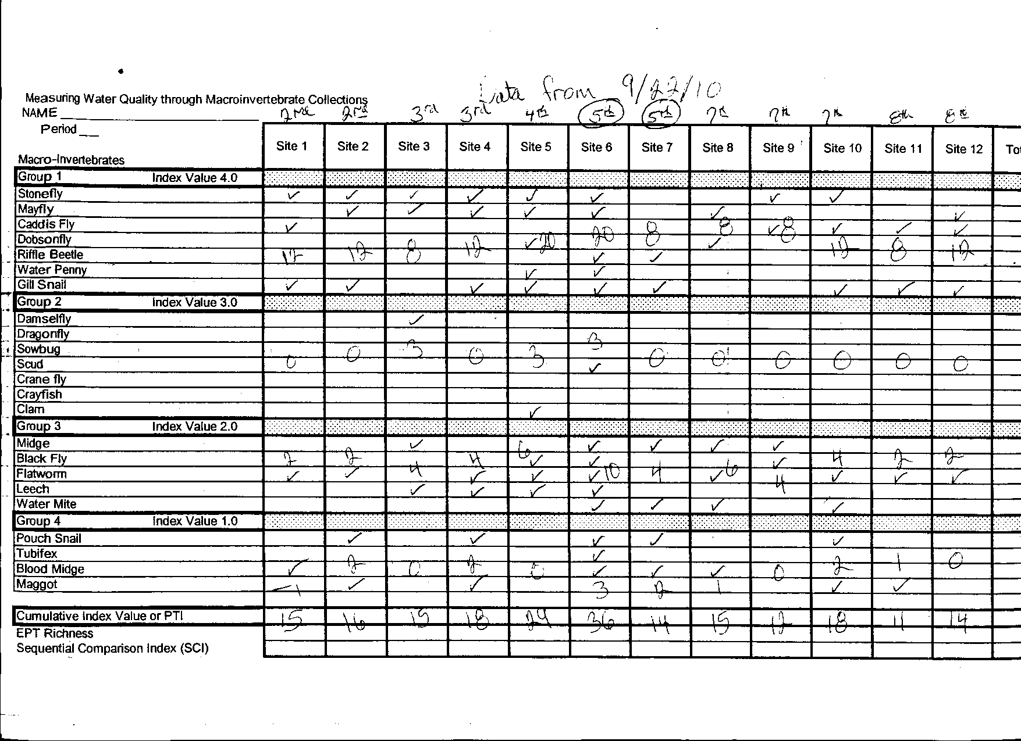

Slide 7
POLLUTION TOLERANCE INDEX (PTI)
23 AND ABOVE EXCELLENT
17-22 GOOD
11-16 FAIR
10 OR LESS POOR

Slide 8
Stream Bottom Sampling
Part 2

Slide 9
Stream Bottom Sampling

Slide 10
5 Screens
Gravel
Fine Gravel
Coarse Sand
Fine Sand
Silt and Clay

Slide 12
Total Stream Bottom Results

Slide 13
Stream Cross-sections Part 3

Slide 14
Stream Bottom Before

Slide 15
Sept. 11, 2000

